Slide 1
Managed Automaton - SESP
Greg Chasteen

Slide 2
Agenda
Brief discussion on Insight, SEEC
Focus on SESP provided APIs
Detailed look at some of the more popular individual APIs
How to combine into common worklfows
Sample SESP open and save utility

Slide 3
Working With PDM Managed Documents
Each Solid Edge PDM client provides an API
Insight
Will provide documention
Solid Edge Embedded Client ( SEEC)
Will provide documentation and examples
Solid Edge for Sharepoint (SESP)
Will provide documented examples

Slide 4
Insight API’s
All Solid Edge API commands are “INSIGHT” enabled
File Open (both interactive command and API) accepts either url or folder based name, cache, etc.
Revision Manager.Open will automatically check-out a file managed by Insight.
There is an INSIGHT automation layer to directly access/execute INSIGHT server specific commands such as download/upload/check-in/check-out etc.
Insight API’s available on both Revision Manager and Solid Edge Framework object models

Slide 5
Insight API’s
Let’s take a quick look at the Insight API’s using Object Browser

Slide 6
Insight API’s
Document containing details on each API
USB drive provided
Advanced Track\Reference Material\InsightExamples.doc
TIP
DisplayAlert will suppress all authentication dialogs as well as the Edit Profile dialog.

Slide 7
SESP and SEEC APIs
Very similar design. In fact, whenever possible an exact duplicate
Access to APIs via SolidEdgeFramework type library
SEEC – SolidEdgeTCE
SESP – SolidEdgeInsightXT
Let’s take a look at them via object browser

Slide 8
SESP and SEEC APIs…. Some differences
ValidateLogin
Purpose: This API is used to authenticate the user before calling any others SEEC functions.
Syntax: Call ObjSEEC.ValidateLogin( UserName, Password, Group, Role,URL)
Parameters:
UserName (Input): Specifies the UserName of the user to authenticate
Password (Input): Specifies the password of the user to authenticate
Group (Input): Specifies the group to which the user belongs. The default group is “dba”
Url (Input) : Specifies the TC database. Can be 2 Tier or 4 Tier
Note: The behavior of the authentication process depends on the display_alerts flag. If the value of the flag is OFF, then Validatelogin () method internally silently (i.e. without showing any Login dialog) does Auto login using supplied credentials.

Slide 9
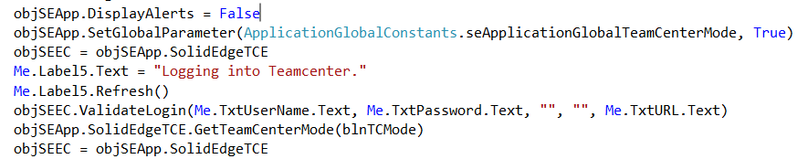
Example logging into SEEC

Slide 10
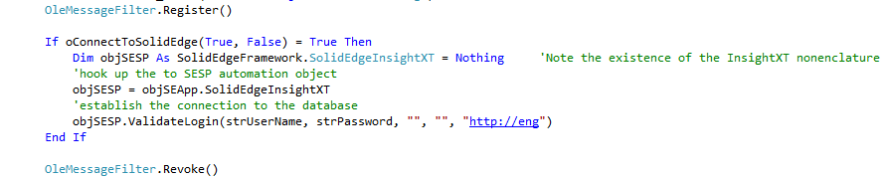
SESP and SEEC APIs…. Some differences
API Name: ValidateLogin
Purpose: This API is used to login into SE SP.
Note:
The API actually uses to log in to the SE SP.
The behavior of the authentication process does NOT depend on the display_alerts flag.
Establishes the connection to the Sharepoint database!

Slide 11
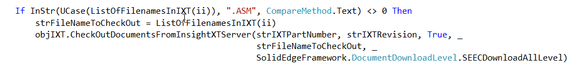
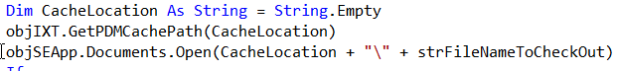
SESP API’s
Notice there was not an Open API…
Slightly different approach than the Insight API’s with regards to C-O\Open, C-I\Close
The Documents.Open API does not take input directly from the SESP database
The document must downloaded to the SESP cache
At this point the Documents.Open from the SESP cache

Slide 12
SESP API’s
Create a new document and save to the database
Create the new Solid Edge document
Prep the document with the necessary information
Part number
Revision
Folder location
Content type
Import the prepped document with the ImportDocumentsToServer API

Slide 13
SESP API’s
Lets look at some common SESP API workflows in detail
You can follow along….
AdvancedTrack\_06-ManagedAutomation-SESP\Programs\SESP-AutomationSamples.sln

Slide 14
More examples
Utility that uses SE SP APIs along with some Sharepoint APIs.
AdvancedTrack\_06-ManagedAutomation-SESP\Programs\InsightXTSPTools

Slide 15

Greg Chasteen Solid Edge Technical Acct. Manager Solid Edge Development
675 Discovery Drive Suite 100 Huntsville, Al 35806
Phone: +1 (256) 705 - 2621 Mobile: +1 (256) 479 - 9055 E-mail: chasteen.gregory@siemens.com

